Slide 1
Lecture 20 Surfaces

Slide 2
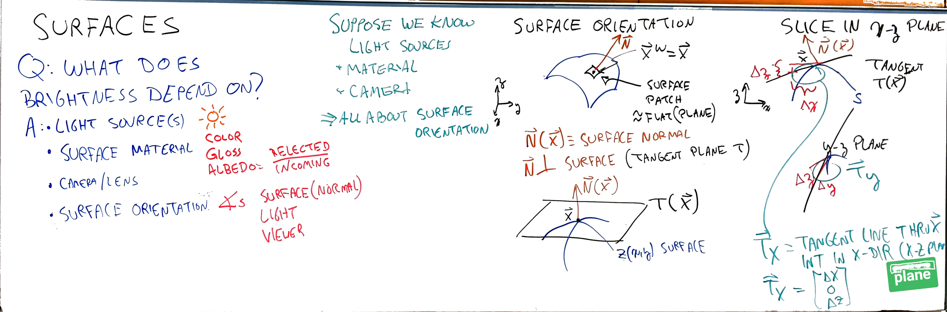
Notes:
Image with background removed

Slide 3
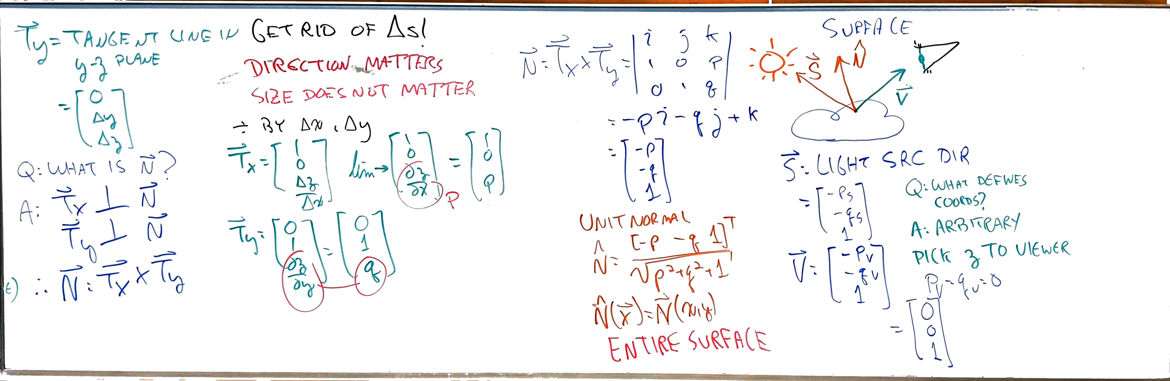
Notes:
Image with background removed

Slide 4
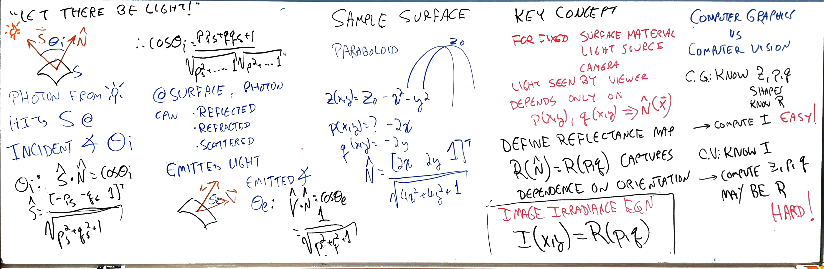
Notes:
Image with background removed

Slide 5
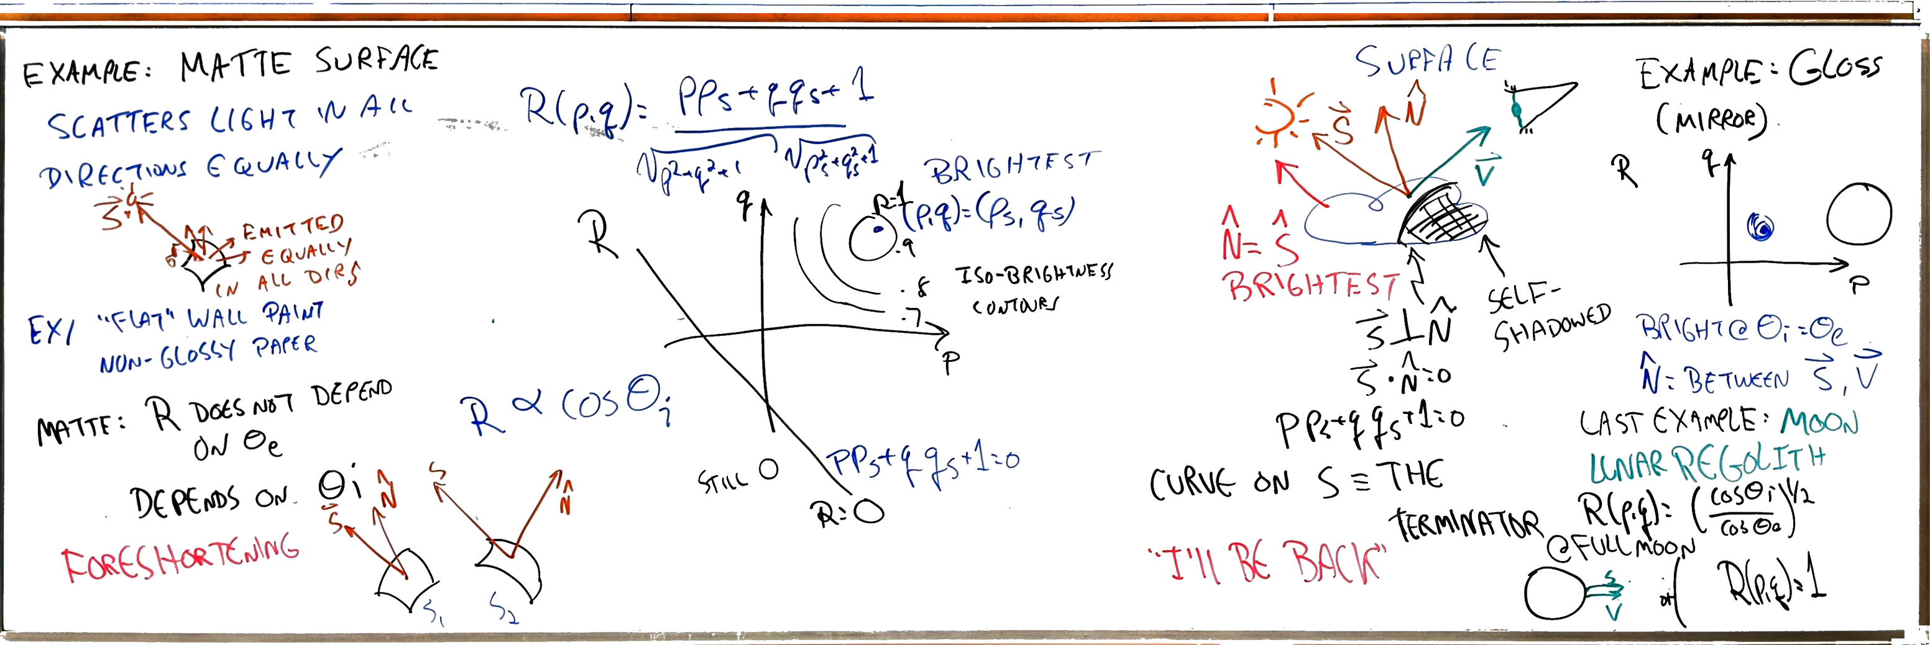
Notes:
Image with background removed

Slide 6
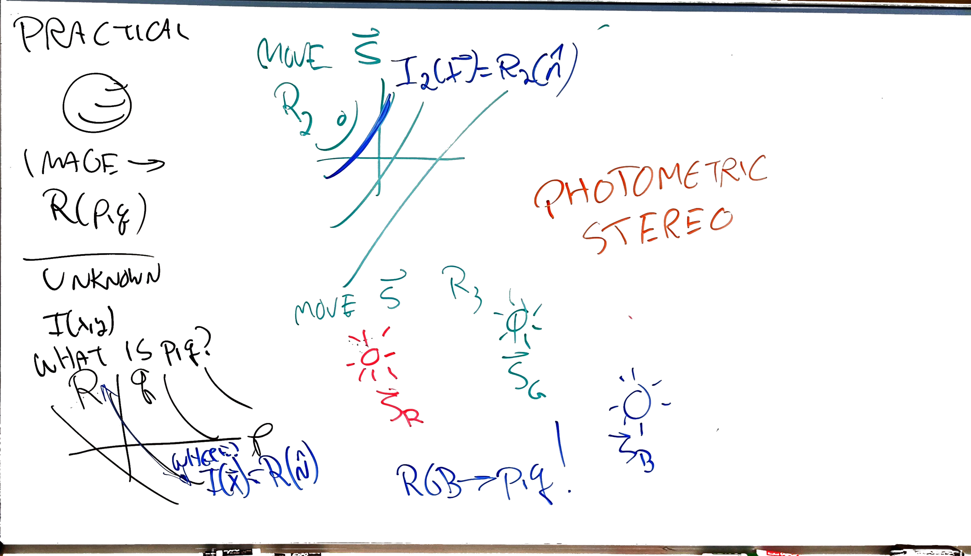
Notes:
Image with background removed

